Slide 1
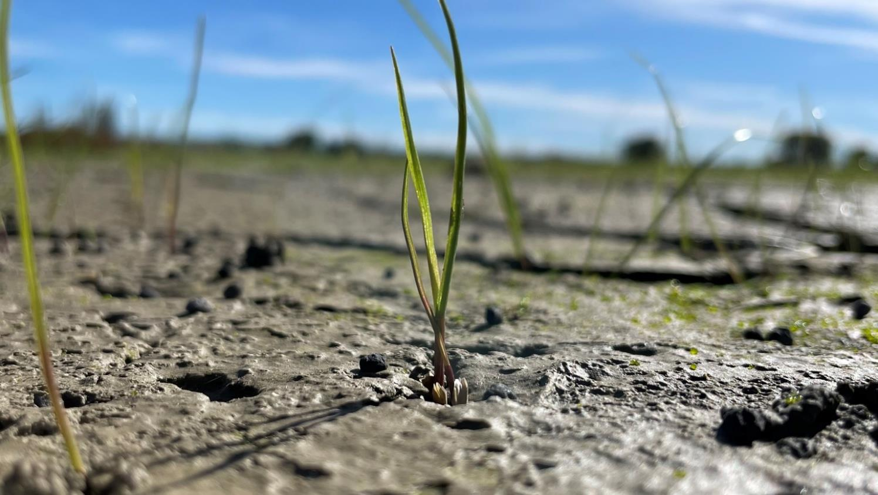





What we knew then and what we know now
Soil Recovery After Cyclone Gabrielle
Alex Dickson & Dan Bloomer (LandWISE Inc.)
Alec Mackay (AgResearch), Alan Palmer (Massey University)
Notes:
Kia ora everyone, my name is Alex Dickson. I work for LandWISE based in Hawke’s Bay.
Cyclone Gabrielle hit the North Island nearly two years ago in February 2023. This was the third extreme weather event to occur in a 40-day period early last year, following Cyclone Hale and the Auckland Anniversary Weekend storm.
My involvement with soil recovery work after Cyclone Gabrielle started about a week after the storm when Dan and I decided we weren’t going to be much use on a tractor or a bobcat in the regional recovery effort.
We decided that we would be more useful to growers in trying to provide information on what they should do in the weeks and months after the flood.

Slide 2
Content
01
Past events
02
Sampling project
Stories and lessons
03
04
What’s next
Notes:
Today I will start by discussing some of the previous events that have helped to inform decision making in the weeks after Cyclone Gabrielle.
I will discuss the Baseline Sampling Project which began shortly after the event, as well as the repeat sampling project we have been working on.
I will finish up by discussing some examples of the changes we have seen over the last year, share a couple of stories and discuss next steps.
I do want to highlight that we don’t have the answers, we are still gathering and interpreting data, and there is more work to do before we can draw any conclusions.

Slide 3
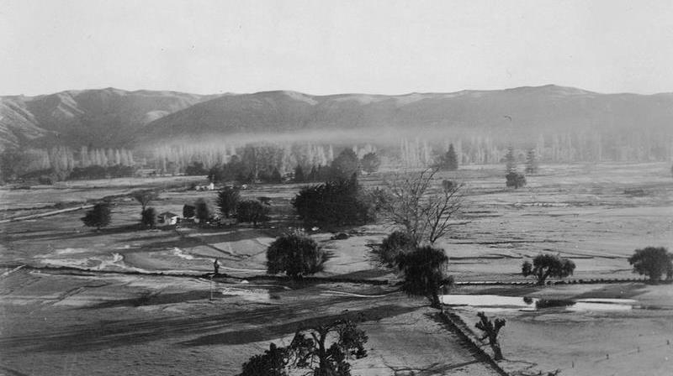
Past Events

Slide 4
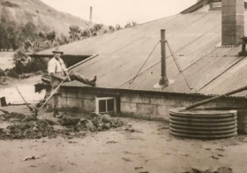
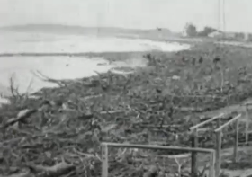
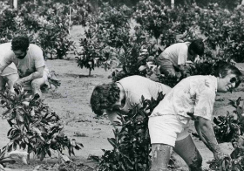
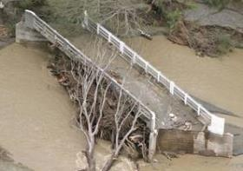
Historic Events
Esk Valley 1938
Gisborne 1948
Bola 1988
SNI Flood 2004
Wilson and Valentine (2005). Regrassing flood damaged pastures. NZ Grasslands
Litherland et al. (2007). Silt Recovery Southern North Island Storm Event 2004
Hill, R.P. Work of rehabilitation- the flood disaster of the Esk Valley. NZ Journal of Agriculture 57 (1) (1938)
McKee, J.G. and Graham, G.J. 1952 Pasture Establishment on Flooded Areas of Gisborne Flats. NZ Journal of Agriculture 84 (3) p197
Gray and Korte (1990). Revegetation of river silt deposits. Fertiliser and lime report
Notes:
From my research there are four key extreme weather events that have occurred in the last century that have been integral to our understanding of flood sediment deposition.
Notably these are the Esk Valley floods in 1938, Gisborne floods of 1948, Bola in 1988 and the Southern North Island Flood in 2004.
Each of these events saw subsequent studies completed focusing on how to reestablish pasture.
There are numerous studies looking at the erosion and slipping of hill country, but apparently less work on the downstream effects of sediment deposits.
A key issue I have had in finding older resources is that there are hard copies in people's garages, articles buried deep in archives, and possibly some information that has been lost in the transformation to digital systems.

Slide 5
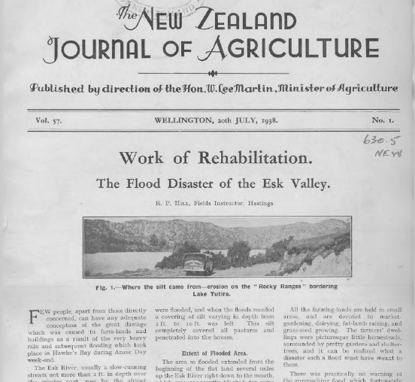
Hill, R.P. Work of rehabilitation- the flood disaster of the Esk Valley. NZ Journal of Agriculture 57 (1) (1938)
Followed February flooding
Average depth 1 m, up to 2 – 3m
Mostly fine sand (83%)
700 ha buried – Lower Esk Valley
Flood relief committee established
Dept. Ag purchased seed
Silt levelled and logs removed, seed hand sown as soon as dry
Trigger for Soil Conservation and Rivers Control Act 1941
Esk Valley 1938
Notes:
The 1938 Esk Valley flood is described as a landmark event, which led to subsequent decades of soil conservation efforts in New Zealand. As settlers cleared land to make way for farmland, so began the basic issues of accelerated soil erosion which culminated to devastation in 1938.
It’s only in recent months I have stumbled over this article from July of that year, which describes the situation after the ANZAC weekend flooding, bearing remarkable similarities to Cyclone Gabrielle 85 years later.
The event followed significant rainfall which fell in February that year, which caused significant flooding along the east coast.
The silt loading in the flood waters was described as ‘an outstanding phenomenon’ evidenced by the depth of sediment deposits in the lower Esk Valley, where 700 ha of agricultural land was buried. The average depth was 1 meter, with sediment up to 3 meters deep in places, this sediment was predominantly fine sand.
A flood relief committee was established, and this committee decided that the best course of action would be to regrass as soon as possible, before the silt became too dry. The Department of Agriculture purchased ryegrass and clover seed which was used to resow pastures along the east coast. The surface of the silt was uneven, so tractors and graders were used to level the surface and pull logs into heaps.
The fact grass was being sown soon after the event was questioned, as it was late autumn, however previous events had shown that regrassing silt once it could be walked on was of value. They knew that regrassing would be unsuccessful after the silt dried out too much, and waiting too long would lead to weed pressure which would be hard to mechanically control now as the sediment was full of debris.
It was recognised that as the sediment was sandy, there was a risk of it blowing away in the summer, which came true in the summer of 1939. Grass did not easily establish in the sand, and much of what did establish was destroyed by these winds and the resulting windblown sand.
The impact of this event was so significant it was a major trigger for the 1941 Soil Conservation and Rivers Control Act.

Slide 6
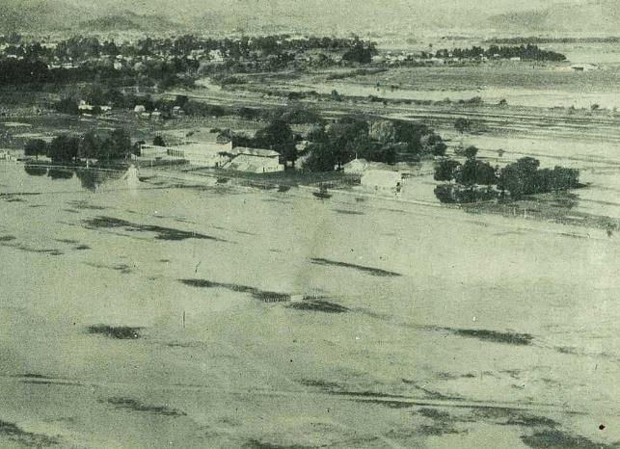
McKee, J.G. and Graham, G.J. 1952 Pasture Establishment on Flooded Areas of Gisborne Flats. NZ Journal of Agriculture 84 (3) p197
Can’t over sow light sediment (sand)
Oversowing medium – heavy silt effective (if still sloppy)
Aeroplanes will be invaluable for resowing
Italian or short rotation ryegrass with perennial rye and red clover best option
Superphosphate at sowing increases strike and early growth
Gisborne 1948
Image from Gisborne Photo News https://photonews.org.nz/gisborne/issue/GPN04_19540916/t1-body-d14.html
Notes:
After a significant flood in Gisborne in 1948, this study experimented with sowing different pasture species on flood sediments at different intervals after the flooding, as well as looking at the response to fertiliser applications.
This is one of the earliest studies available which focuses on downstream effects rather than upstream erosion control.
The study found that oversowing light or sandy sediments is ineffective, and instead this sediment should be cultivated immediately after the flood waters have receded.
On medium to heavy silts, cultivation won’t be possible until the sediment is fully dry, however seed can be oversown successfully provided the sediment has drained but is still sloppy.
They identified the use of aerial sowing as an invaluable tool to cover large areas of land with seed.
Italian and short rotation ryegrass struck the best and grew well over the winter. Perennial ryegrass and red clover struck well but did not persist over the winter.
They emphasise that oversowing can establish a successful pasture sward, provided the timing is right and the sediment has not fully dried. Sediment texture is an important factor in success as well.

Slide 7
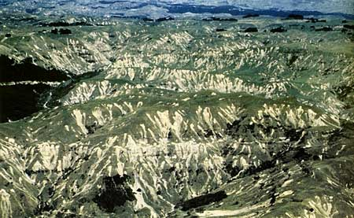
Gray and Korte (1990). Revegetation of river silt deposits. Fertiliser and lime report
Oversowing on deep high pH alluvium
Sand or sediment <10cm easy after cultivating
Grasses ‘satisfactory’, legumes poor strike
Moata= most vigorous
DAP increases establishment
Timing most impt factor
Bola
1988
Image from Te Ara https://teara.govt.nz/en/photograph/14550/landslides-in-cleared-country
Notes:
Gray and Korte extended the 1948 study to specifically look at oversowing on deep, high pH alluvium deposits.
They discuss that if sediment is less than 10cm deep or sandy, then resowing can be done with minimal issues after cultivation.
Where sediments were deep or silty, it was more difficult to re-establish pasture.
They found grasses established well via oversowing, but legumes performed poorly.
Moata was most vigorous species, and exceeded the growth of all other treatments, even when no fertiliser was applied.
Applications of DAP did increase performance.
Concurring with the 1948 study, they concluded that timing is the most important factor for success of reestablishing pastures- it is best after it has been drained but not fully dry.

Slide 8
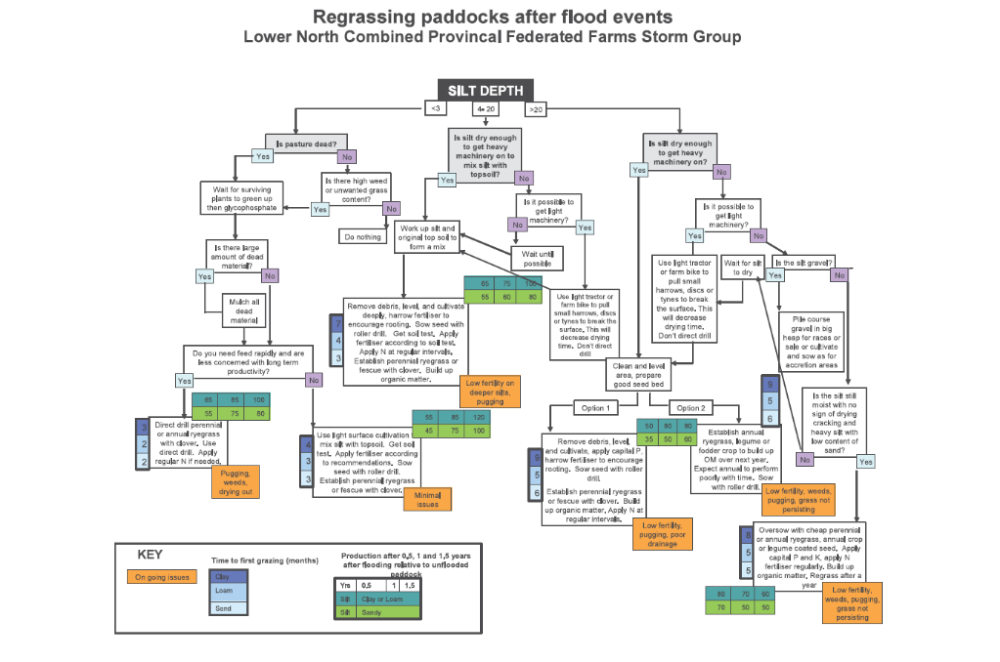
Litherland et al. (2007). Silt Recovery Southern North Island Storm Event 2004
SNI Flood 2004
Notes:
Many of you here today will remember the February 2004 Southern North Island Storm which impacted much of this region, I grew up north of here in Kimbolton and remember the floods quite vividly.
Studies following this event collected data from Regrassed sites approximately 10-14 months after the flood.
A key output of these studies was this decision support tool for regrassing.
I have included this image in a lot of presentations, and every time I can hear the audience muttering that it is the world's worst slide. It’s okay, you don’t have to read it!
The main considerations when looking at sediment management options are sediment depth and texture, and it is emphasised that farmers should get something growing as soon as possible- something that is on recorded as early as 1938.
It was established as early as 1952 that annual ryegrass, is one of the best options for regrassing silt, and later studies support this.
The information in this tool is great and it was widely used to support decision regrassing for a lot of farmers and growers after Cyclone Gabrielle, 20 years on.

Slide 9
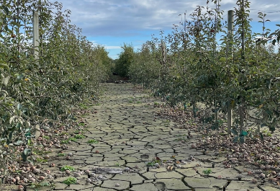
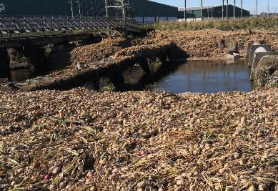
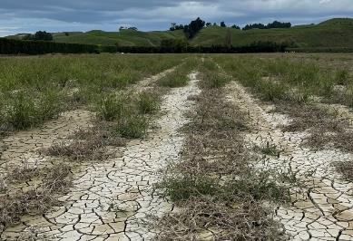
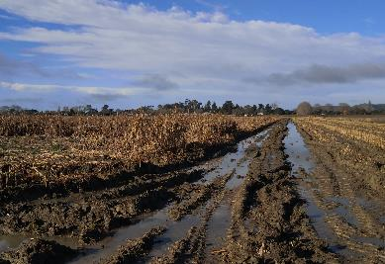
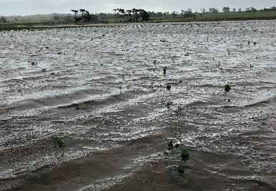
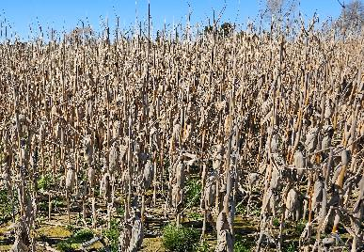
Rebuilding our soils..
Apples- Hawke’s Bay
Onions- Hawke’s Bay
Tomatoes- Hawke’s Bay
Maize- Gisborne
Kumara- Northland
Maize- Wairoa
Notes:
We know the impact of Cyclone Gabrielle was different to these previous storm events, in that it didn’t just impact pastoral land, it impacted highly productive, versatile soils, which grow a range of permanent tree and vine crops, and field crops.
Previous studies focused on how to reestablish pasture, not how to go back to growing high value crops like tomatoes, onions or apples.
We want to know how growers can recover from an event like Cyclone Gabrielle, what the ongoing impact to production might be, and what actions can be taken to return to full production.
While Cyclone Gabrielle was a truly devastating event for many people, there is a unique opportunity to learn from this event.
On the East Coast we have a ‘living lab’, where we have been trying to gather as much information as we can, to build the knowledge basket, and help in the recovery from this event, but also for the next time this happens.
7.30

Slide 10
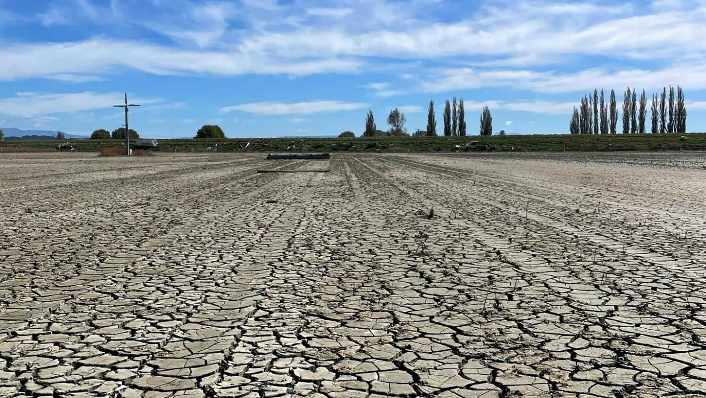
Cyclone Gabrielle Sampling Project

Slide 11



Baseline Sampling
Measurements
Physical
Chemical
Biological
Sediment depth
Visual Soil Assessment
Texture
Bulk Density
Nutrient fertility
Contaminants (14 sites)
Earthworms (abundance and species)
eDNA (TBC)
Faecal source tracking- ESR
Notes:
In the weeks after the event, a consortium of organizations came together to work out how we should approach a study. This included LandWISE, Massey University, AgResearch, Plant and Food Research, Gisborne District council and some of the horticultural product groups.
These organisations made resources available internally and went above and beyond to act quickly, engage with landowners and were roped into trudging through the mud to help complete sampling.
We started with just wanting to look at nutrients and contaminants, however because we were sampling quite soon after the event, we took the opportunity to complete a more detailed analysis measuring physical, chemical and biological properties.
This included sediment depth, visual soil assessment, texture and bulk density, nutrient fertility and earthworm species and abundance. At a selected few sites in Hawke’s Bay, we looked for chemical and biological contaminants
We also collected and froze samples from each site in the hope some environmental DNA testing could be completed- ESR have been able to use some of our frozen samples as part of a food safety project testing for Faecal contaminant sources and listeria.

Slide 12



Sampling to date
Baseline Sampling-
(1-3 months)
Repeat Sampling- Spring (6 months)
Repeat Sampling-Autumn (12 months)
111 sites
Hawke’s Bay
Gisborne
Northland
155 samples
10 sites
Hawke’s Bay
16 sites
Hawke’s Bay
Crop measurements
Stage 1
Stage 2
Notes:
We now have data from three time points, making up what we are calling Stage 1 and Stage 2 of the project.
These time points include our baseline sampling project where data was collected from 111 sites from three regions approximately 30-90 days after the cyclone, our repeat sampling in the spring, revisiting just 10 sites in Hawke’s Bay, and then our autumn repeat sampling which is from 16 sites in Hawke’s Bay.
The baseline sampling was funded by MPI, with funding administered by Vegetables NZ, and the repeat sampling as been funded by Vegetable Research and Innovation.

Slide 13

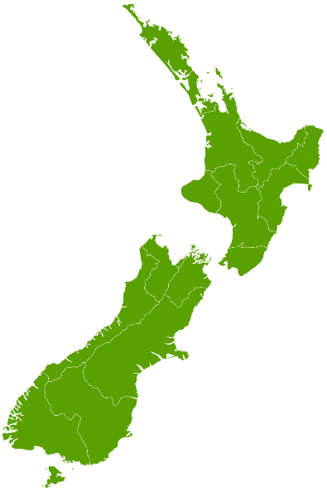
Sample locations
Northland
6 sites
Gisborne/Tairawhiti
39 sites
Hawke’s Bay
Hastings/Napier/Otane 61 sites
Wairoa 5 sites
Total= 111 Sites
Notes:
Along the east coast sampling stretched from as far south as Otane and as far north as Ruatoria. We were able to sample sediment from many impacted catchments, as well as different points along the catchment to look at sediment differences as water moved over the landscape.
We sampled a 50m transect which represented 1 sediment depth class, relating back to the decision support tools and the depths described- so <5cm, 5-20cm and >20cm.
We sampled a range of different land use types across the impacted areas, including permanent tree crops, vine crops, and field crops.
In Northland sampling was completed around Dargaville on areas grown for kumara, where the issue wasn’t sediment deposition, but rather water inundation for extended periods of time.
David and Bryce from GDC completed sampling in Gisborne and Wairoa, we had support from Massey, AgResearch and Plant and Food in sampling Hawke’s Bay, and in Northland Luke Posthuma completed sampling of behalf of Kumara NZ.

Slide 14
Repeat Sampling- Paired Sites
16 paired sites
10 of these retested in Spring
Matched by sediment scenario
Location, sediment texture, depth
BUT managed differently
Results
Sampling repeated in autumn
Harvest data collected (where applicable)
Notes:
Following the collection of the baseline data, we decided it would be good to revisit these sites to better understand the change that had occurred in the short term.
These sites were matched by location, sediment texture and sediment depth, but have been managed differently since the event. Most of the sites were previously used for vegetable production, with the addition of one vineyard and one pastoral block.
Where sites were planted in crop over the summer, we have collected crop yield and quality data from along our established transect.

Slide 15
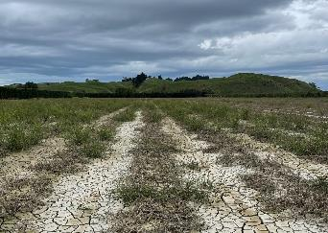
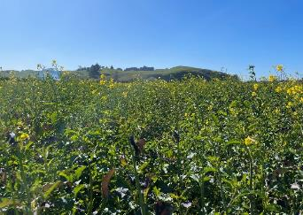
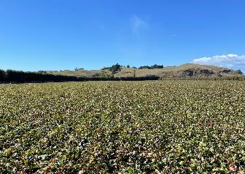
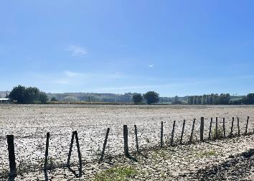
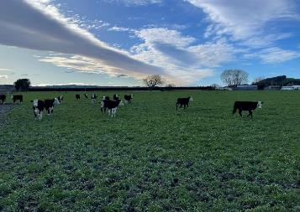
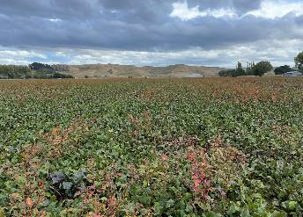
Repeat Sampling- Paired Site Example
Site 1
Baseline
Spring
Autumn
Site 2
Notes:
One example is a pair of paddocks close together where <5cm of silty clay loam sediment was deposited.
On Site 1 had the sediment incorporated once the ground had dried out, and a winter cover crop was planted.
Site 2 sediment was left undisturbed on the surface, grass seed was flown on, and cattle grazed through the late winter and spring.
Both sites were planted in beetroot in the spring. The aim with pairing sites is to look at what the outcome of different management has been in to both soil and crop production in different scenarios.

Slide 16
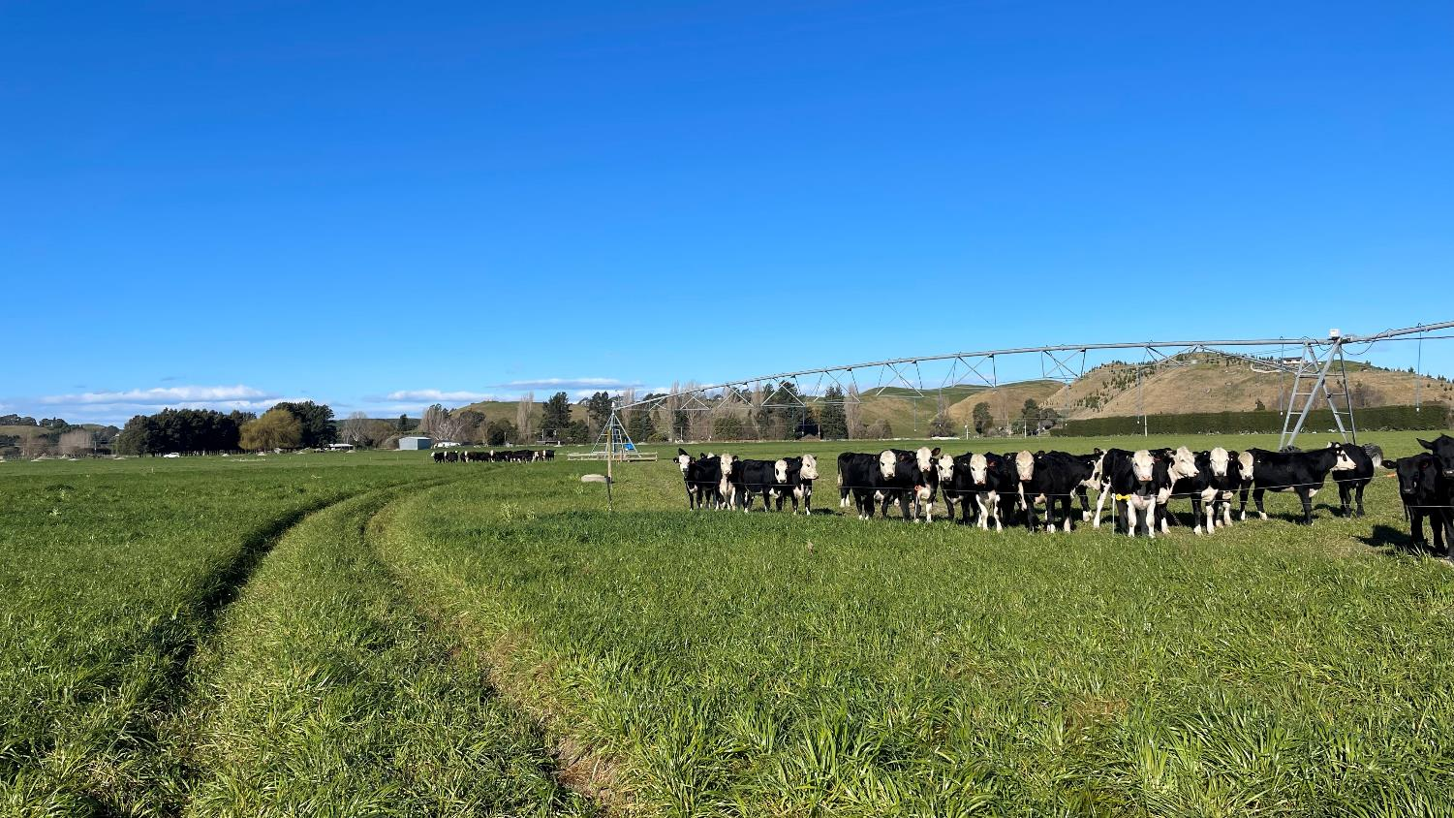
Stories + Lessons

Slide 17
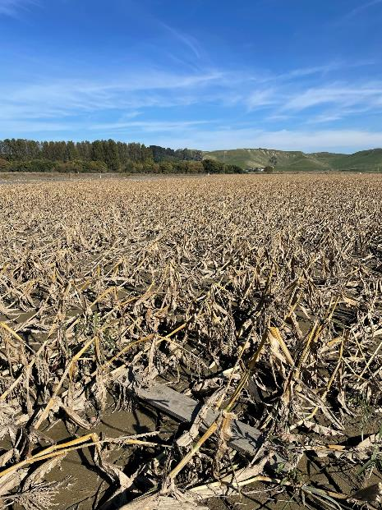
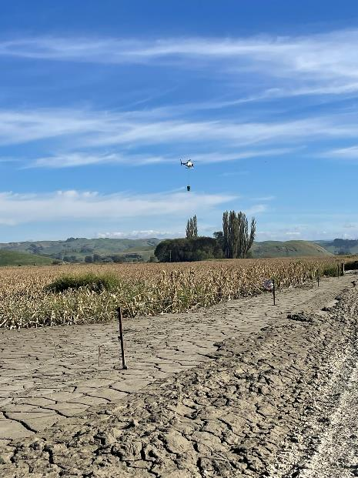
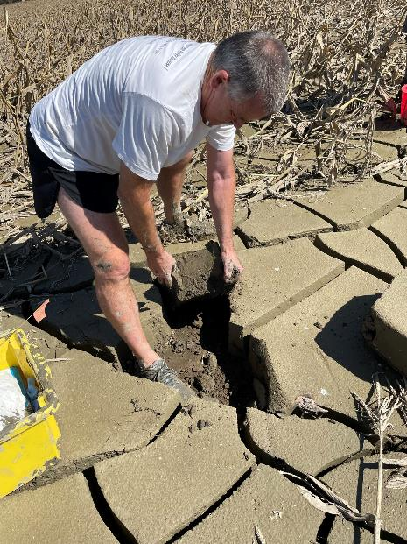
Puketapu 16-20th March 2023
Seed flown on 30 days after cyclone
Notes:
As the saying goes a picture tells a thousand words, so I’m now going to share some photos and a couple of stories from some of the sites we have been following since the flood.
This site was one of the first sites we sampled after the Cyclone. Sediment texture was a silty clay loam and was between 3-50cm deep across the 60ha block.
This paddock was in sweetcorn where we actually had a nitrate trial set up before it was wiped out by the cyclone.
We visited this site three weeks after the cyclone once the water had drained, and we discussed with the grower what they should do.
We took a trip back in time to the 1952 study in Gisborne, which as I mentioned, found that over sowing annual ryegrass seed on medium to heavy sediment, where water has subsided, but the sediment was still sloppy was the fastest and most effective way of re-establishing plants.
If the sediment is still sloppy the seed will have enough moisture to get going, and the surface is a bit too wet for birds to stand on, so in theory they won’t eat as much of the seed.
This grower was understandably a little nervous about spending a whole lot of money on flying seed on at that time, however, took the leap about a week after out meeting.

Slide 18
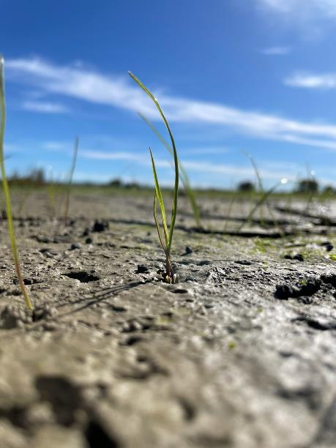
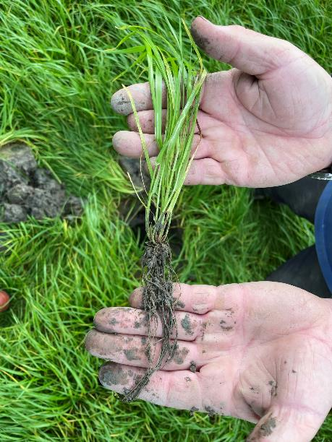
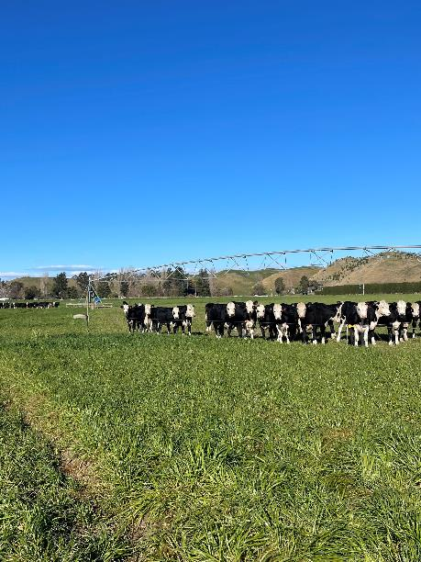
Puketapu
31st March 2023
45 days after Cyclone
9th May 2023
84 days after Cyclone
12th September 2023
210 days after Cyclone
Notes:
I went back out a couple of weeks later to look at what had germinated.
Where the sediment was deeper and wetter, the seed germinated on the sediment surface. Where the sediment was drier, the seed germinated mostly in cracks that formed after the sediment started to dry.
3 months after the cyclone things looked quite different. It was possible to walk over pretty much the whole farm, as pumps were reinstated, and grass grew.
The roots of the annual rye grass were about as long as my forearm in places and had reached down into the original soil below.
A key benefit of getting something growing as soon as possible was that it gave the grower options. They could probably have cropped the whole farm if they wanted to, however they are in a position where they don’t need to rush back into crop and could potentially leave in pasture for a couple of years.
They grazed light cattle; cut grass for Baleage and left the soil and sediment largely undisturbed. The managed to drive their irrigator out of the mud and watered the grass over the driest part of summer to keep it growing. The moata started to run out at the end of the summer and was sprayed out and direct drilled into permanent grass.

Slide 19
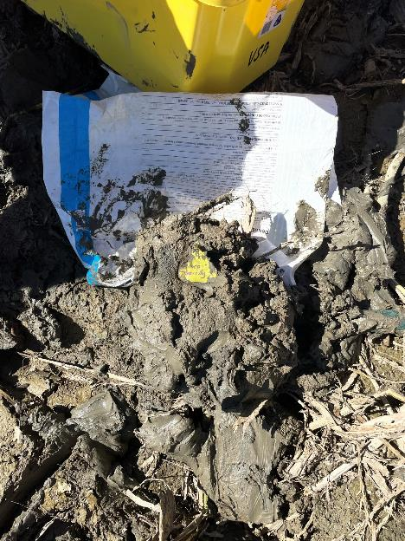
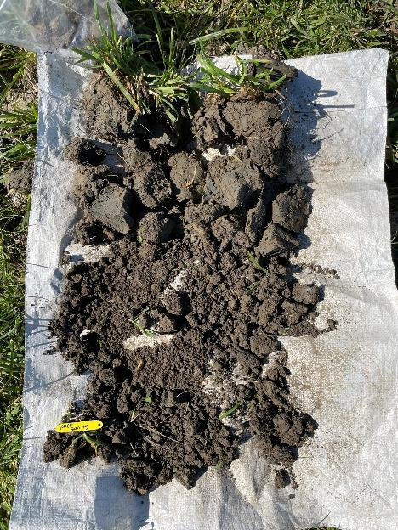
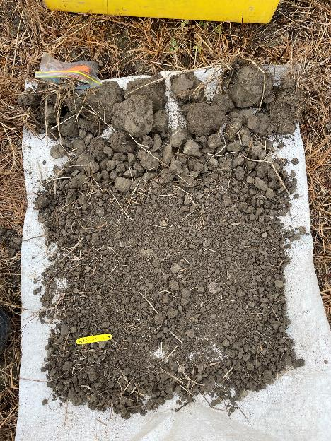
Puketapu
March 2023
Sept 2023
March 2024
Notes:
After visiting a few sites after the cyclone, I started to compare the sediment to different types of desserts- you can see that when we did our first VSA it was maybe more of a chocolate mousse consistency, of course much too wet to do a proper VSA, but does show that what was there to start with was a structureless, wet, lump.
Overtime this has started to look more like soil. In the last photo, the clods on the top of the VSA are the result of biological processes more than anything, as the ground still hadn’t been cultivated.
The nice thing about this scenario is that it is essentially “what the book said to do” and it was incredible to see it work in practice. And to make a point, we have known what to do with sediment for a long time.
There were a range of approaches taken after the cyclone, decisions made were based on a range of factors, but there was a lot of land left bare over the winter. Growers who did leave land bare, had fewer options in the following spring, or had to use a lot of horsepower to coerce the sediment into doing what they wanted in the spring.
The lesson is tried and true, just get something growing as soon as possible!

Slide 20
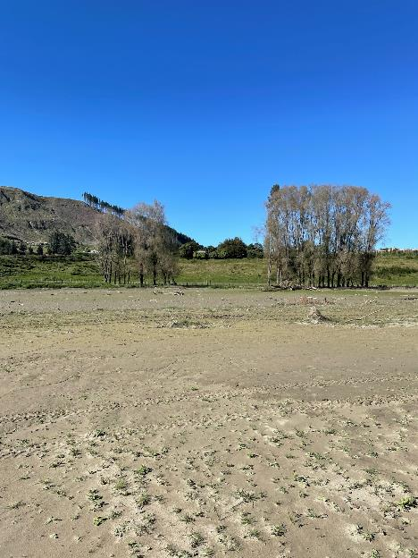
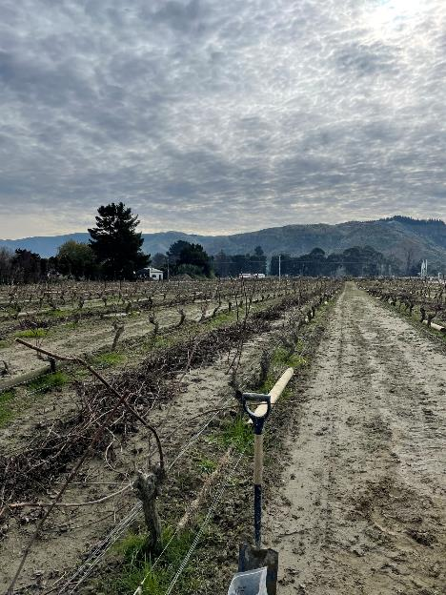
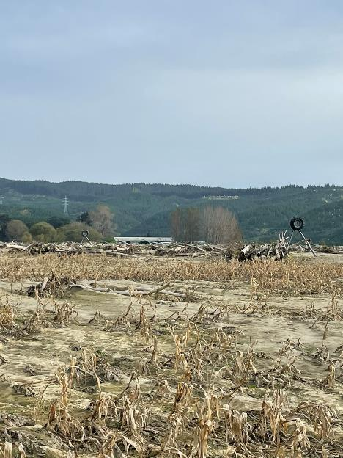
Esk Valley April – May 2023
Pastoral Farm – Top
Vineyard – Middle
Cropping farm – Bottom
Notes:
Moving on to the Esk Valley, which is a really interesting scenario as it is an area prone to flooding and deep sediment deposition, like what we saw in 1938.
What we have seen in the time since cyclone Gabrielle is a huge effort to remove sediment from impacted areas, which will have come at an enormous financial and energy cost. What we know is the Esk Valley flooded long before Cyclone Gabrielle and it will continue to flood long after.
In each of the scenarios on the screen, fine sand was deposited at least one meter deep. None of these farmers had the ability to remove sediment, or just didn’t want to, so they have worked with their new growing surface.

Slide 21
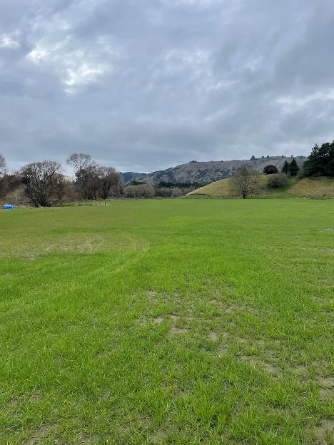
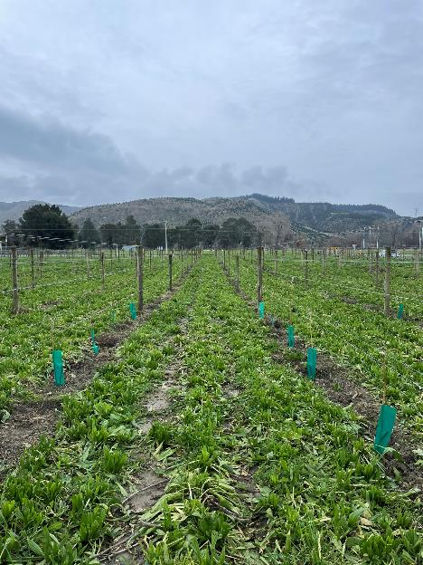
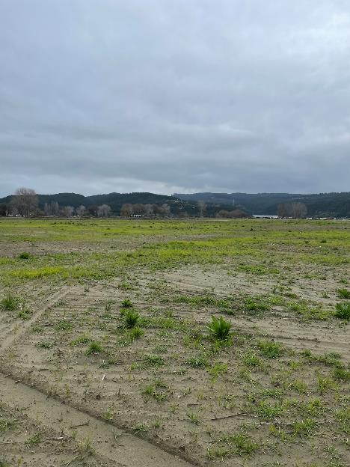
Esk Valley July 2024
Pastoral Farm – Top
Vineyard – Middle
Cropping farm – Bottom
Notes:
These photos were taken a bit over a year since those first photos.
The pastoral block was immediately drilled with oats and has since had sorghum planted which was grazed with cattle and is now in annual rye grass. They are focusing on increasing organic matter and ensuring there are living roots in the soil to support the soil building process.
The vineyard planted plantain, chicory and clover as soon as they could drive between the vines. Initially it was plantain and chicory dominant, until it was grazed in the spring, and the clover was allowed to persist. They pulled the posts up, so they are in line with the new ground height and are now replanting vines that didn’t survive. This is the only Esk site where we found earthworms 18 months on.
The cropping farm, at the bottom of the catchment, has very little growing. A large grower was leasing the block until the cyclone, and the block was left too long before planting and was too dry to get anything established. We met up with the owner at this time, he’s in his late 80’s and farmed the block through Bola and another big flood prior to Bola.
Despite the block not growing much, he’s of the view that it’s all part of a cycle, and with time the farm will become productive again. The logs left behind have been chipped and will be left to breakdown and then the mulch will be spread back on the land. He’s not in a rush to go back to cash crops, a diverse pasture mix has been planted, and some species are persisting. The main goal is to stabilise the sand. Maybe in a year or two it can be cropped again.
My main point here, is there are other options to removing the sediment in this scenario. We have been here before and I’m certain we will be here again! While the sediment is low in nutrients and organic matter, it can eventually grow productively. In rebuilding the Esk Valley, I do think we need to take the lessons from historical events, and perhaps work with the land scape, rather than against it. And again, the biggest lesson, get something growing as soon as possible.

Slide 22
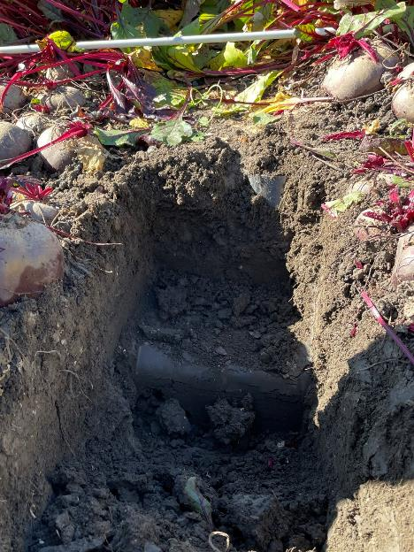
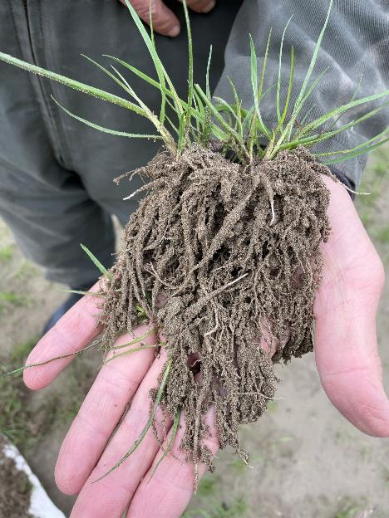
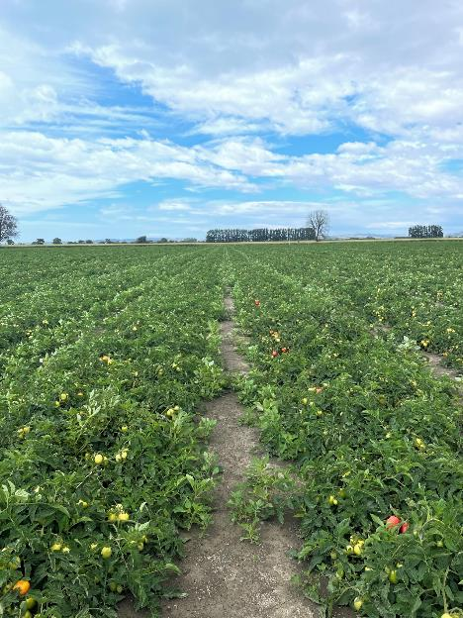
Other interesting bits
Sediment plough pan
Esk Valley
2023 Wattie’s Tomatoes
Notes:
I’ve just thrown these photos in as they are interesting to think about.
The photo on your left shows an area planted in beetroot, where 5cm of silty sediment was ploughed in. And what you can hopefully see is a pan that has formed about 12cm under the soil surface. So essentially the profile as been inverted and there is quite nice soil on top, and then this incredibly hard pan underneath. Maybe not such an issue for these shallow rooted beets, but possibly an issue for deeper rooted crops.
The middle photo shows a grass plant that has been dug up from a sandy site. The thing that impressed me here is the amount of sediment clinging to the roots, I think making up a rhizosheath, so indicates that there is microbial activity happening around the roots, even in sand.
The last photo is a paddock growing tomatoes for Wattie’s. This site had 10cm of silt, clay sediment on top, which was incorporated (don’t ask how many passes because it was many passes), however still managed to grow a 100T tomato crop, which is very impressive.
My point here is that there is so much happening out in the field, and I think capturing this information is important so we can better understand the impacts of sediment deposition on soil and on different crop types.

Slide 23



Next steps
Complete Stage 2- Revisit paired sites 2 years on
Report on findings from 4 rounds of sampling & 2 cropping seasons
Stage 3 – Revisit all sites
Funding to keep collecting data 3-5 years
Assess medium - long term impact
Bring all Gabrielle project findings together
Keep information together and accessible forever.
Notes:
So far, we have completed Stage 1 and most of Stage 2 of our project. We will revisit our paired sites in autumn 2025 to see what changes have occurred after 2 years.
Stage 3 is a proposed longitudinal study to return to all sites over a 3–5-year period to look a medium to long term changes. This would be a collaborative project with a number of organisations involved.
The project work completed to date has looked at the short-term impact. We don’t have a strong understanding of the long-term effects of sediment deposition or of the long-term impacts of different management practices.
My last point is that an effort needs to be made to work out how we make sure the data being collected and insights gained after cyclone Gabrielle will be accessible, really quickly the next time this happens.
Conversations are underway between many project groups to work towards a solution on how we best collate all of our collective findings, at this stage we are working towards a special edition of a journal.
We caught up with a farmer in Wairoa after the cyclone who said, ‘I farmed through Bola, I know we did something, but I’m buggered if I can remember what I did’. I have trawled though archives and actual garages for months trying to find older studies, and they are out there, and they are valuable, but are bloody hard to find. There are some articles referenced where the title sounds perfect for what I am looking for, but when I have gone looking, I have been told that unless the author is still alive and has a copy, it has been lost to time. Information isn’t that helpful if no one can find it.
We also know a lot and have known a lot about sediment recovery for a long time. How do we make sure we can get the message of “get something growing as soon as possible” to those that need it and provide the resources to do so, as soon as possible, so we can set farmers and growers up for success?
There is power in storytelling and passing knowledge onto the next generation. We hope that the work we are doing alongside the other projects run by FAR, Plant and Food and others will help to tell the story of Cyclone Gabrielle on the east coast and leave a legacy for next time.

Slide 24
Soil Recovery After Cyclone Gabrielle
“Building Back Better”
alex@landwise.org.nz
Notes:
I’d like to acknowledge the support we have had from MPI & Vegetable Research and Innovation in funding this work. An additional thanks to Massey University, AgResearch, Plant and Food Research, Gisborne District council and Luke Posthuma on behalf of Kumara New Zealand in collecting samples from across many impacted areas.
I’d also like to acknowledge the farmers and growers who have engaged with this project and allowed us access to their farms.
A special thanks to Sally Anderson who has been instrumental in securing funding and engaging with product groups to share information.
Thank you for being here today. If you have any questions, please feel free to get in touch.
There might be a few minutes for questions now?

